Slide 1
Ombudsman & Family Members Operations Security DD MMM YY
Notes:
Introduce yourself

Slide 2
Overview
References
What is Operations Security (OPSEC)
Threat
Critical Information
Indicators
Vulnerabilities
Social Media
Risk
Countermeasures
Periodic Assessment
Ombudsmen and OPSEC
Educate your family members

Slide 3
References
Department of Defense Instruction (DoDI) 8170.01, 2 January 2019, Online Information Management and Electronic Messaging
SECNAVINST 3070.2A, 9 May 2019, Operations Security
NTTP 3-13.3, December 2022, Operations Security
SECNAVINST 5720.44C W/CH-2, 21 February 2012, DON Public Affairs Policy and Regulations
Navy Social Media Handbook (2023)
Marine Corps Social Media Handbook
Notes:
-Current version of SECNAVINST is 3070.2A.
-Mention the OPNAV?
-Plenty of other references pertaining to OPSEC, but these are the two primary ones, and they both focus on the Navy and Marines, not Joint commands or other branches of the military. For joint commands, check JP 3-13.3.

Slide 4
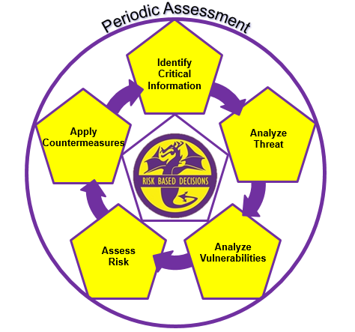
Operations Security (OPSEC)
The OPSEC cycle
Identifies, controls and protects sensitive, critical unclassified information and indicators about a mission, operation or activity
Assesses potential threats, vulnerabilities and risk
Utilizes countermeasures to mitigate an adversary's collection capabilities against a friendly operation and periodically assesses friendly OPSEC effectiveness
Reduces the risk of our adversaries exploiting our vulnerabilities and obtaining our critical information
OPSEC IS NOT just about social media or protecting ship’s movement!
Notes:
Stress the 6-step cycle is what OPSEC Officers and we use. They don’t really need to understand the 6 steps, the details of the cycle, but they need to understand what OPSEC is, in a general sense.
-Information can be unclassified, but still be “sensitive” and cause harm. We’ll explain.
-We will explain what exactly an adversary, or threat is in the next slide. We will also explain what a vulnerability is in a few minutes.

Slide 5
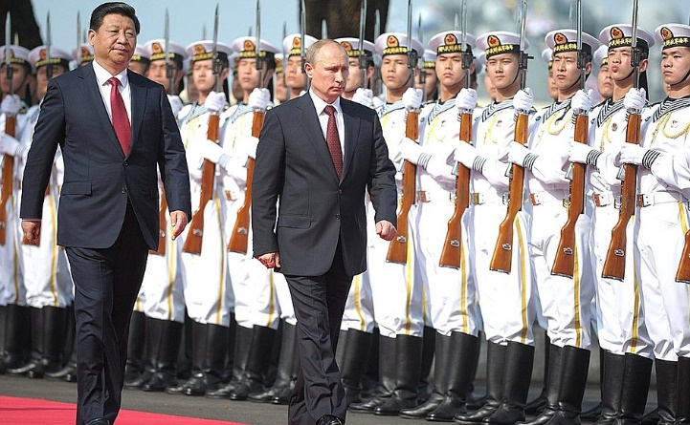
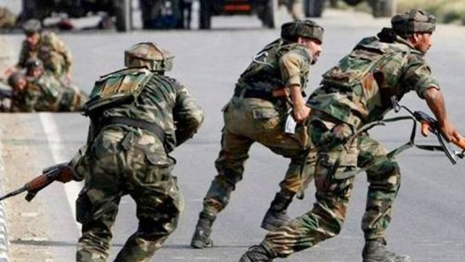
Threat
Capabilities and intentions of an adversary to undertake any action detrimental to the success of friendly activities or operations.
Conventional Threats
Military opponents
Nations
Unconventional Threats
Terrorists (foreign and domestic)
Hackers
Insiders (Spies)
Thieves, stalkers, etc.
Notes:
Mention there are “bad guys” out there monitoring our phone calls, hacking into our wireless internet, pretending to be innocent people on social media. They want the information you talk about to your Sailor. -Stress that there we have enemies who intend to disrupt the ship’s mission, and even cause us harm.

Slide 6
Critical Information
Specific, critical information we must protect to ensure success
Information the adversary needs to prevent our success
Operational Information
Eight Operational Aspects:
Capabilities
Strength/Personnel
Location
Future location of ship/squadron
Intent
Readiness
Timing
Methods
Notes:
Unclassified information we need to protect and the adversary wants to collect
Briefly discuss each operational aspect, give examples if you can
Critical Information will be derived from the eight operational aspects of operations, shown on this slide.
- Presence – where your organization or unit is currently located
- Capability – The unique abilities your unit lends to operations
- Strength – The number of units or personnel coupled with the ability to withstand great force
Intent – What your unit plans to do
Readiness – Level of preparedness to execute
Timing – Specific timelines of events
Location – Where your unit will specifically deploy
Method – The way the mission will be executed
Examples:
- Capabilities- how fast the ship can go. What weapons are onboard, what systems, new technology. - Intent - what does the ship intend to do? What is their mission? Specific missions or exercises.
- Method - how is the ship going to accomplish its mission.

Slide 7
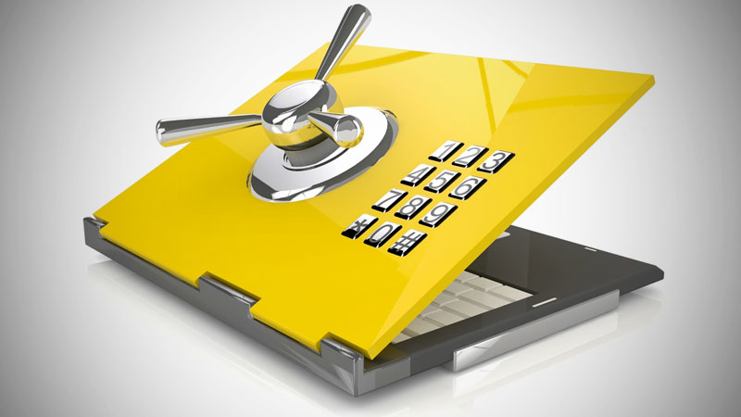
Personal Information
Some examples of sensitive information that apply to your family life:
Names and photos of you and your children
Usernames and passwords
Length and location of spouse’s deployment
Social Security Numbers
Credit card/banking information
Significant dates (birthdays, anniversaries)
Addresses and phone numbers
Everyday schedules
Travel itineraries
Notes:
How can these specific pieces of information be used against you? For example, if a terrorist learns about your travel itinerary to fly overseas, it could lead the terrorists to your loved one’s ship or overseas command.
-Passwords, social security numbers, etc. could enable a hacker to access your bank and/or credit cards, draining your bank accounts and ruining you or your military spouse’s credit….and possibly affecting their security clearance. Almost everyone in the Navy holds a security clearance.
-Although rare, adversaries could kidnap family members, especially when traveling or stationed overseas, and possibly hold them for ransom….or worse.

Slide 8
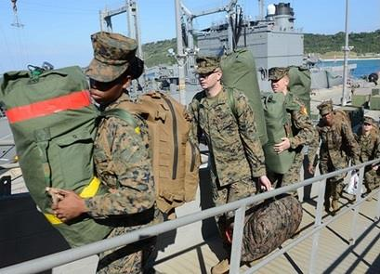
Indicators
Friendly, detectable actions that reveal critical information and vulnerabilities
Longer working hours
Rehearsals
Sudden changes in procedures
Onloads
Large troop movements
Not all indicators are bad
Notes:
-Indicators can point to vulnerabilities and possibly reveal Critical Information.
- Your family members should not talk about these potential indicators via e-mail, social media, unsecure phone calls, etc.

Slide 9
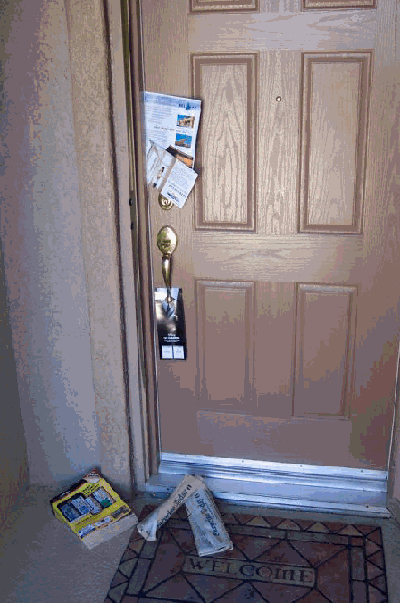
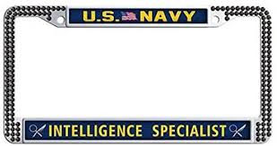
Personal Indicators
Notes:
This slide depicts common personal indicators for families.
-How can this be harmful? It draws unnecessary attention to yourself, openly declaring to the world you are affiliated with the military. Don’t make Yourself a target to the bad guys!
-Don’t forget about regimented family routines

Slide 10
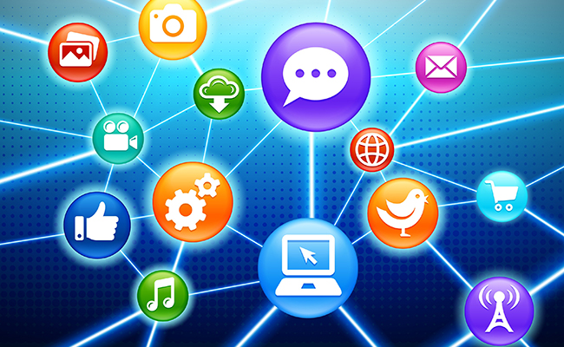
Vulnerabilities
Weakness the adversary can exploit to access critical information
Some common vulnerabilities include:
Lack of awareness
Apathy
Social media
Social engineering
Data aggregation
Trash
Unsecure phone calls
Notes:
-A vulnerability is something that can be exploited to cause damage or disruption. This slide is a list of the most common vulnerabilities a person or organization may experience.
-Basically anything on the internet. Social networking can include dating sites

Slide 11
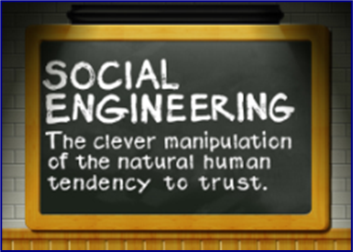
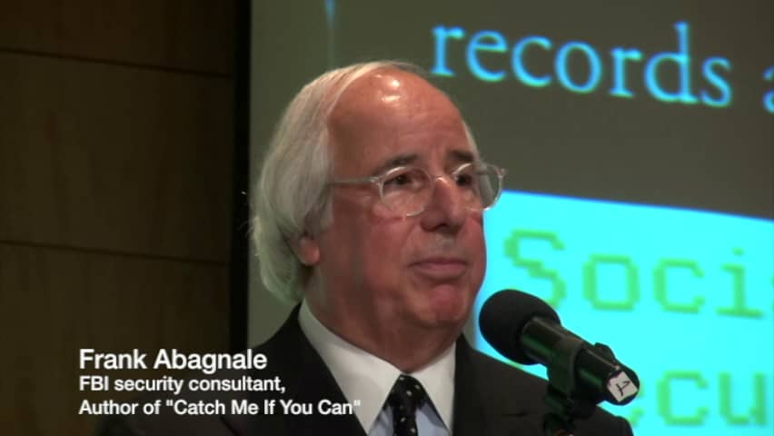
Social Engineering
Using human interaction to manipulate an individual to provide information.
Pretending to be someone they are not
Fake credentials
All over the internet
Online social media “friends”
Dating sites
Phishing Scams
Fake bank e-mails
Credit card e-mails
Phone calls
Notes:
Social engineering- I’m not a bad guy, I’m here to be your friend, or I represent a reputable company and I’m here to help you.
Questions start innocently, general, broad questions, but get more specific as they go on.
“Spidey-sense” alarm should go off if too many, or too specific ship/mission related questions are asked.
Most people are innocent and just curious, but use common sense and trust your gut instinct! Bad guys, spies, terrorists, use this technique, every day!
Can also mention quid pro quo, this for that.
“Your bank account may have been accessed by an unauthorized user.”

Slide 12
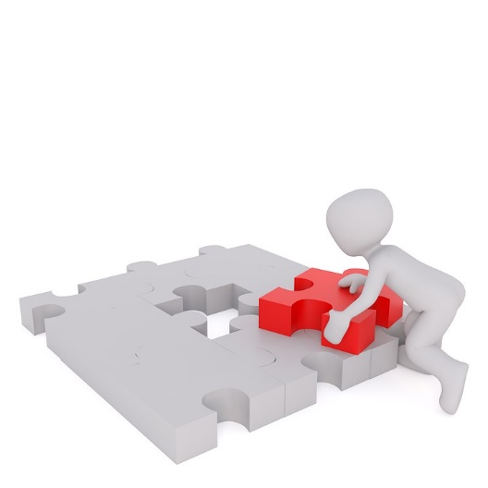
Data Aggregation
Unclassified, but critical information collected from multiple sources
“Open source” collection provides the adversary most of their intelligence
Manchester Document: 80% of information collected is done so legally
Internet
Trash
Media
Small details put together- give adversaries the big picture
Notes:
-Define “open source”
-Like a pieces of a puzzle. Bits of unclassified information from social media, from your trash, from the news can all be fused together to give the enemy just enough information to figure out your family member’s location and his/her mission.

Slide 13
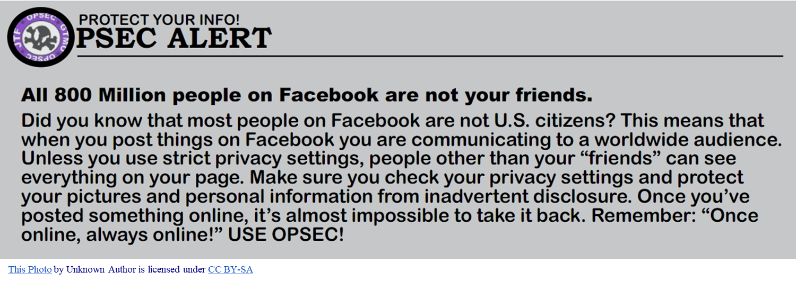
Social Media
Do
Use groups on Facebook
- Only accept people you know
- Validate or verify friends and associates
Monitor the site
Regularly check security/privacy settings
Use a password and/or encryption if WiFi
Do Not
Use public, unsecure wireless networks
Use for passing or sharing official Navy information
Post PII or CI
Notes:
- Social media raises morale. Most Commanding Officer’s advocate the use of social media. It is NOT all “bad”.
- Social media is the easiest way to communicate with large groups of people. It is highly recommended for ombudsmen to use Facebook and other social media sites to keep in touch the family members. Facebook is the easiest way to communicate with large groups of people at the same time.
If an ombudsman is running a Facebook group, it is recommended to keep the group open. People think or assume that if a Facebook group is closed to the general public, it is unable to be seen by outsiders. This causes some people to think it is acceptable to post sensitive information. Adversaries could easily hack into the closed group to access the page. Also, anybody who shares a post from the closed group to their personal page has made it accessible to the general public.
You should always know who is a member of your page. Block any suspicious followers to your pages.
Explain what PII is; Obviously, never post PII on social media, whether it be a service member or family member. Also, never go into detail about your personal life on social media. The adversary could be watching your online activity. Don’t give him an opportunity to take advantage of you because of the information you provide on Facebook.
Facebook changes or updates their security settings often. When an update occurs, it may change your security settings back to default, which isn’t very secure. Always keep an eye on this.
Be very careful about your online activity when you are using a public wireless network (airport, hotel, coffee shop, etc), especially if you are overseas. Always assume the adversary is watching. Equipment can be easily obtained to monitor devices on public networks.

Slide 14
Communicating
OK. To make this easy, I just won’t say anything!
Do
Talk in past tense
Ship’s movement
Port calls
Personnel transfers
Talk in general terms
Location
Mission/exercises
Talk about feelings. How are you?
Personal family life
Do Not
Use codewords
Talk specifics
Timelines
Location
Future location
Mission/exercises
Operational Aspects
Notes:
-We want to talk and stay in touch with our loved ones. It’s natural and important to stay connected. It’s ok to talk with your Sailor, but the conversation cannot reveal any critical information. Please do not ask your Sailor about these specific things, and if he does reveal it, remind him/her about OPSEC and do NOT relay that information to anyone else.
-Example of Speaking in vague/general terms: We’re somewhere in the Mediterranean Sea, conducting an exercise. All is well. A little tired, but I’ll get some more sleep tonight. Instead of talking specifically: We’re 10 miles southwest of Crete Island, conducting an exercise, codenamed “Undersea Merman” with our new Sonar Tech system that was just flown to the ship yesterday. The helicopter landed very awkward. Those pilots from Naval Air Station Rota don’t know how to fly!
-When it comes to future port calls, homecoming port return, do NOT try to be sneaky and use codes to try to communicate dates. The adversaries will figure it out!
-The Ombudsman may be told by the ship’s Commanding Officer regarding a homecoming date well in advance, and that’s his prerogative. Do not try to correct him, but if you know dates well in advance, it is your responsibility to limit who receives that information and inform them to not broadcast it until a specified time.
- Social media is probably the most common way to communicate in the 21st century, but it’s not the only way. Sometimes we still talk on the phone, e-mail, and to really go “old school”, a letter is written!

Slide 15
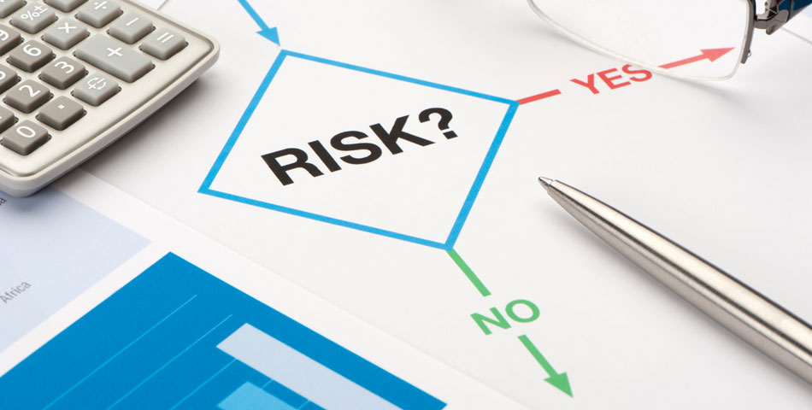
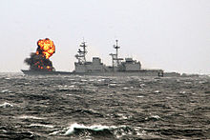
Risk
The probability an adversary will gain knowledge of your critical information and the impact if they are successful
Impact: What could happen if critical information falls in the wrong hands?
Lives lost
Mission failure
Money lost
How much are you willing to risk?
Don’t think this can’t happen
Notes:
Your loved one on the ship, along with the OPSEC Program Manager will conduct risk analysis.
Just understand what the bottom line is if critical information falls in the wrong hands!
-Give an historical example of critical information compromised leading to a tragedy. 9/11? Terrorists, hackers, insider spies get caught every year.

Slide 16
Countermeasures
Anything that effectively negates or reduces an adversary's ability to exploit vulnerabilities or collect & process critical information
Use strong passwords, encryption
Shred paperwork
Monitor children’s social media and phone calls
Vary routes
Modify schedules
Educate your family
What is critical information?
What are your vulnerabilities
There are “bad guys” watching and listening
Notes:
This is how to prevent the bad guys from collecting our critical information by mitigating or eliminating our vulnerabilities.

Slide 17
Periodic Assessment
Requires an evaluation of your, and your families OPSEC posture and ability to protect Critical Information.
Is conducted to determine if anything has changed; are your countermeasures working as expected?
Did we miss something in the execution of the OPSEC cycle?
Notes:
Understanding that OPSEC is a continuous cycle; you must always look at how we are:
conveying and protecting critical information
Identifying who “really” needs the information that we are projecting in a public venue
and then assess, if what we are doing to prevent our adversaries from gaining access to our critical information is working, or do we need to do more?

Slide 18
Ombudsman and OPSEC
Knowledge of the command’s critical information
Who is the command’s OPSEC Officer/Manager?
Do you get invited to any OPSEC working group meetings?
Families must understand the importance of OPSEC
Educate other family members whenever possible
Facebook groups
Meetings
Notes:
-The Ombudsman plays an important role to the command. He/she has responsibilities….one of them is to build a strong OPSEC posture between family members and the command.
- Sailors bring home their command’s Critical Information. Family members must know what information they receive is critical and what is not. The easiest way to do ensure that family members are not posting Critical Information is to educate them. There are several ways to spread the OPSEC message across the FRG. If you maintain a newsletter, you can push the OPSEC message that way. Always have some sort of OPSEC training at any and all FRG meetings that you have, whether you do it or you request outside assistance (NOST). Family members protecting information is just as important as the service member protecting the information. Educate the families, especially teenagers that are active on social media.

Slide 19
Available Resources
NOST Website: https://www.navifor.usff.navy.mil/opsec/
NOST Email: NAVY_OPSEC@us.navy.mil
Command OPSEC Officer
Notes:
Navy social media website?
Chinfo.navy.mil

Slide 20
Summary
References
What is Operations Security (OPSEC)
Threat
Critical Information
Indicators
Vulnerabilities
Social Media
Risk
Countermeasures
Periodic Assessment
Ombudsmen and OPSEC
Educate your children and other family members

Slide 21
Contact Information
Your Logo here
Your Command OPSEC Program Manager information here.
NAVY_OPSEC@us.navy.mil
757-203-3656
NAVAL INFORMATION FORCES
ATTN: NAVAL OPSEC SUPPORT TEAM
115 LAKE VIEW PARKWAY
SUFFOLK, VIRGINIA 23435

